Slide 1
E-LEARNING PLATFORM Final conference | 07/06/2018

Slide 2
MAIN FEATURES
FLEXIBLE
CUSTOMIZED
EASY TO USE

Slide 3
ON-LINE PLATFORM
The on-line platform is accesible from Project website:
http://ww.silverworkers.net

Slide 4
USERS REGISTRATION
Self registration system: fill in a registration form
Notes:
You must have received your Log In details from your teacher/ training coordinator, if not, you can contact them to aks them.

Slide 5
ACCESING THE PLATFORM
monika.wasilewska
Username
Password
Notes:
You must have received your Log In details from your teacher/ training coordinator, if not, you can contact them to aks them.

Slide 6
LANGUAGES
The training contents are already available in different project languages:

Slide 7
STRUCTURE
Structure and contents are the same for different languages:
Modules→ Units →Pdf + Activities →Test
Notes:
Once you have selected your language, the complete training course is displayed, you can start from the beginning, o you can select the Unit you are more interested in, just clicking on the title.

Slide 8
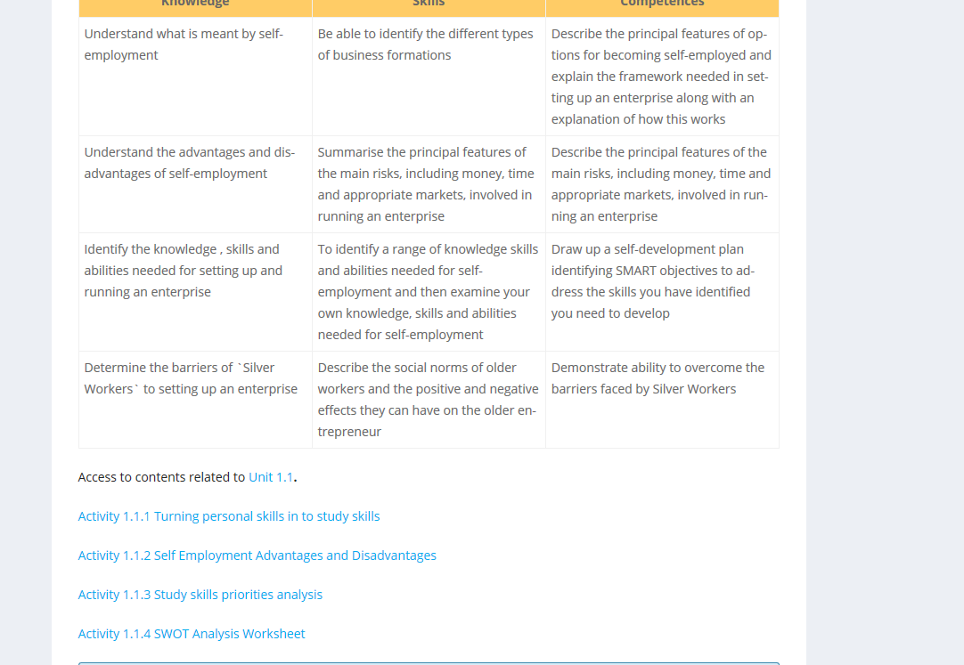
UNITS
UNIT CONTENT - PDF
ACTIVITIES RELATED TO UNITS
Notes:
Once you access to the Unit you will see the link to download contents. Furthermore, in some units you can find some complementary activities.

Slide 9
TEST
Once the student has completed the unit, below can be found the test for assessment:
Notes:
Once you have completed the training contents related to a Unit, below you can access the evaluation. You need to pass the 80% of assessment to have your diploma.

Slide 10
PROGRESS
In the main menu, the students can check their progress in the course and the % of approved tests

Slide 11
UTILITIES
WEBMINAR
FORUM
FILE SHARE AREA

Slide 12
Thanks for your attention!
gracia.benitez@fundecyt-pctex.es

